Slide 1
CSE 464 : Software Quality Assurance and Testing
Testing Object Oriented Applications Janaka Balasooriya

Slide 2
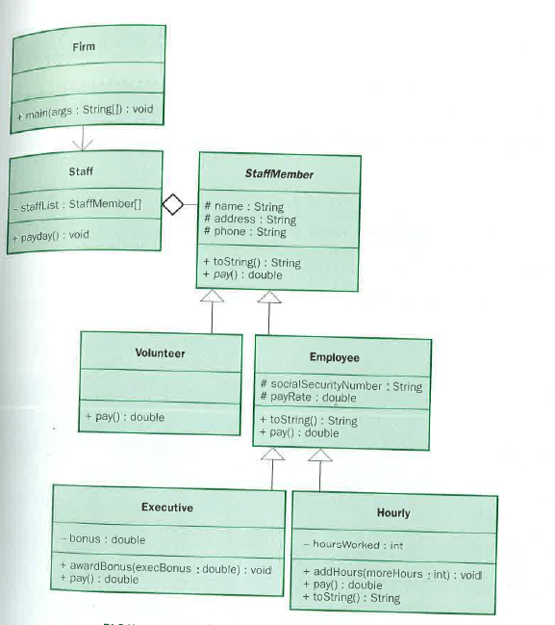
How do we Test This Application – Integration Testing?

Slide 3
Integration Testing : A Quick Review

Slide 4
Integration Testing Strategies
Integration testing is a systematic technique for constructing the software architecture
while at the same time conducting tests to uncover errors associated with interfacing.
Options:
  • the “big bang” approach
  • an incremental construction strategy

Slide 5
Incremental Integration
The program is constructed and tested in small increments, where errors are easier to isolate and correct.
Three main approaches:
Top-down
Bottom-up
Sandwich

Slide 6
Top Down Integration
Top Down Integration is an incremental approach to construction of the software architecture.
Modules are integrated by moving downward through the control hierarchy, beginning with the main control module (main program.)
Modules subordinate to the main control module are incorporated into the structure in either a depth-first or breadth-first manner.

Slide 7
Top Down Integration
A
top module is tested with
stubs
B
F
G
stubs are replaced one at
a time, "depth first"
C
as new modules are integrated,
some subset of tests is re-run
D
E
Depth-First Integration – A, B, C, D, E, F, G
Breadth First Integration – A, B, F, G, C, D, E

Slide 8
Top down Approach

Slide 9
Bottom-Up Integration
A
B
F
G
drivers are replaced one at a
time, "depth first"
C
worker modules are grouped into
builds and integrated
D
E
cluster

Slide 10
Bottom Up Approach

Slide 11
Sandwich Testing
A
Top modules are
tested with stubs
B
F
G
C
Worker modules are grouped into
builds and integrated
D
E
cluster

Slide 12
Sandwich Approach

Slide 13
Next Time => Object Oriented Integration Testing

